Slide 1
Error handling

Slide 2
Functions of Error Handler:
Error Detection
Error Report
Error Recovery
Whenever an error occurs, the parser can handle it and continue to parse the rest of the input.
types of error: logic, run-time and compile-time error

Slide 3
logical errors: Unexpected or undesired outputs or other behaviour may result from a logic error
executed code does not produce the expected result
program debugging
runtime errors: adverse system parameters or invalid input data.
lack of sufficient memory, memory conflict
compile-time errors: before the execution of the program.
Syntax error or missing file reference

Slide 4
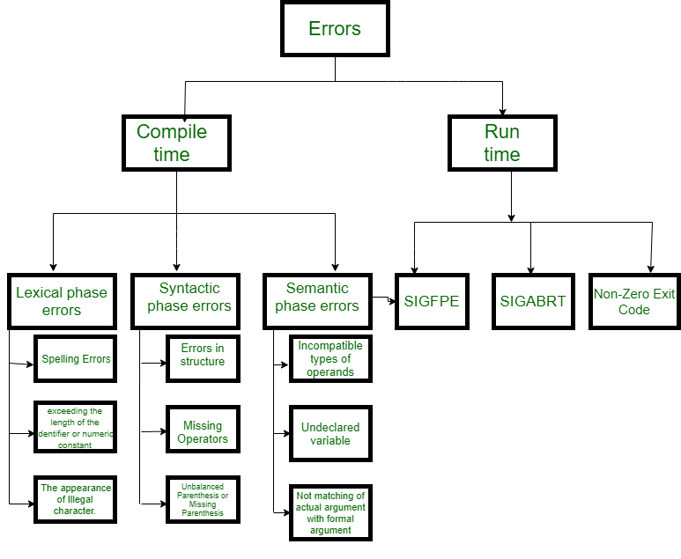
Lexical : This includes misspellings of identifiers, keywords or operators
printf("Geeksforgeeks");$
Syntactical : a missing semicolon or unbalanced parenthesis
sitch() {...}
Semantical : incompatible value assignment or type mismatches between operator and operand
int a[10], b;
.......
.......
a = b;
Logical : code not reachable, infinite loop.

Slide 5
Detect errors Viable prefix property
Goal detection of an error as soon as possible without further consuming unnecessary input
How: detect an error as soon as the prefix of the input does not match a prefix of any string in the language.
Lexical error
Error recovery
Lexical phase
Panic Mode Recovery
In this method, successive characters from the input are removed one at a time until a designated set of synchronizing tokens is found.
Synchronizing tokens are delimiters such as; or }
The advantage is that it is easy to implement and guarantees not to go into an infinite loop
The disadvantage is that a considerable amount of input is skipped without checking it for additional errors

Slide 6
Syntax Phase error recovery
1. Panic Mode of error Reovery
2. Statement Mode recovery
Parser performs the necessary correction on the remaining input so that the rest of the input statement allows the parser to parse ahead.
The correction can be deletion of extra semicolons, replacing the comma with semicolons, or inserting a missing semicolon.
A disadvantage is that it finds it difficult to handle situations where the actual error occurred before pointing of detection.

Slide 7
3. Error production
If a user has knowledge of common errors that can be encountered then, these errors can be incorporated by augmenting the grammar with error productions that generate erroneous constructs.
If this is used then, during parsing appropriate error messages can be generated and parsing can be continued.
The disadvantage is that it’s difficult to maintain.
4. Global Correction
The parser examines the whole program and tries to find out the closest match for it which is error-free.
The closest match program has less number of insertions, deletions, and changes of tokens to recover from erroneous input.
Due to high time and space complexity, this method is not implemented practically.

Slide 8
Semantic Error Recovery
If the error “Undeclared Identifier” is encountered then, to recover from this a symbol table entry for the corresponding identifier is made.
If data types of two operands are incompatible then, automatic type conversion is done by the compiler.

Slide 9
Advantages in error recovery
Improved code quality
Increased productivity
Better user experience
Better debugging:
Consistent error handling
Reduced maintenance costs
Improved software performance

Slide 10
Disadvantages
Slower compilation time
Increased complexity
Risk of silent errors
Potential for incorrect recovery

